Slide 1


EduStream
App Identity & Design Implementation
LEARN WITHOUT LIMITS

Slide 2









Branding & Visual Language
Color Palette
Typography
#0D2B55
#1E88E5
#26C6DA
#F5F7FA
Poppins Bold
Poppins SemiBold
Poppins Regular
WCAG 2.1 AA compliant colors optimized for high-resource and outdoor visibility.
Geometric sans-serif chosen for legibility on low-resolution screens.
Tone of Voice
Iconography
Encouraging & Inclusive
The EduStream icon combines an open book (knowledge) with a signal wave (connectivity).
Plain language for technical processes
Clear feedback: "Well done! Your answers saved."

Slide 3




System Design & Panel Architecture
Mobile-First Design Philosophy
EduStream is built on a modular architecture designed for high accessibility and low-bandwidth resilience. The interface prioritizes clarity and professionalism, using a persistent navigation model familiar to modern mobile users.
Admin Panel
Instructor Panel
Student Panel
Governance, infrastructure monitoring, and platform analytics.
Course management, student tracking, and content delivery.
Adaptive learning interface, assessments, and collaboration.

Slide 4






Student Panel: Learning Interface
Interface Design
Adaptive Accessibility
Simplified Navigation: Intuitive UI tailored for low-resource settings, ensuring students find content quickly.
The interface dynamically adjusts based on real-time connectivity status to ensure learning never stops.
Courses Page: Seamless browsing of enrolled subjects with visual progress indicators and module tracking.
Low-bandwidth mode (Audio/Text only)
Visual Hierarchy: High-contrast elements and clear typography (Poppins) to reduce cognitive load.
Offline progress synchronization
54%
72%
MOBILE ACCESS
COMPLETION RATE

Slide 5

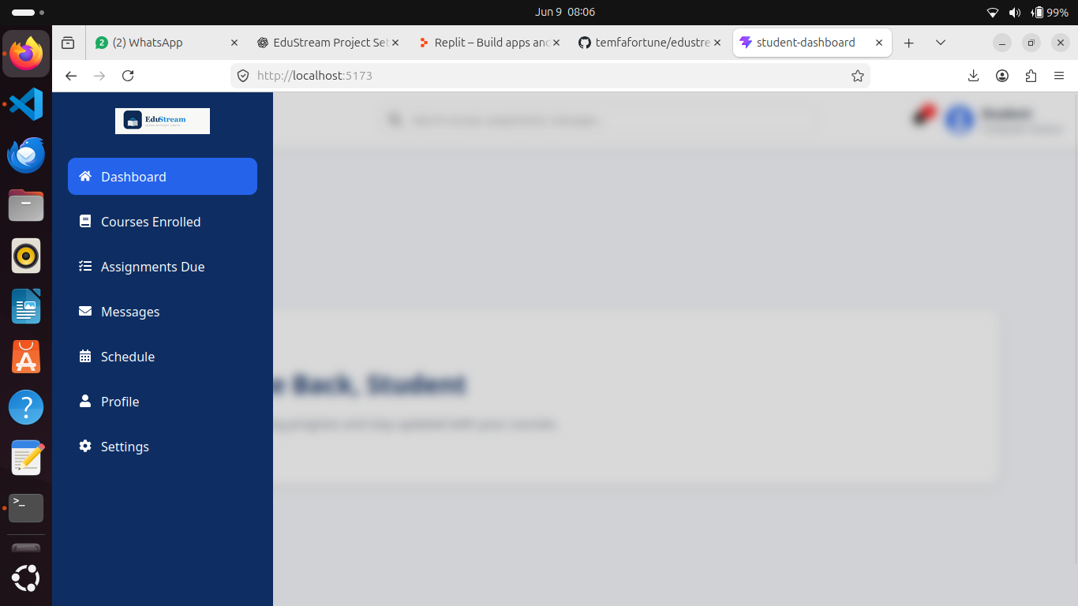
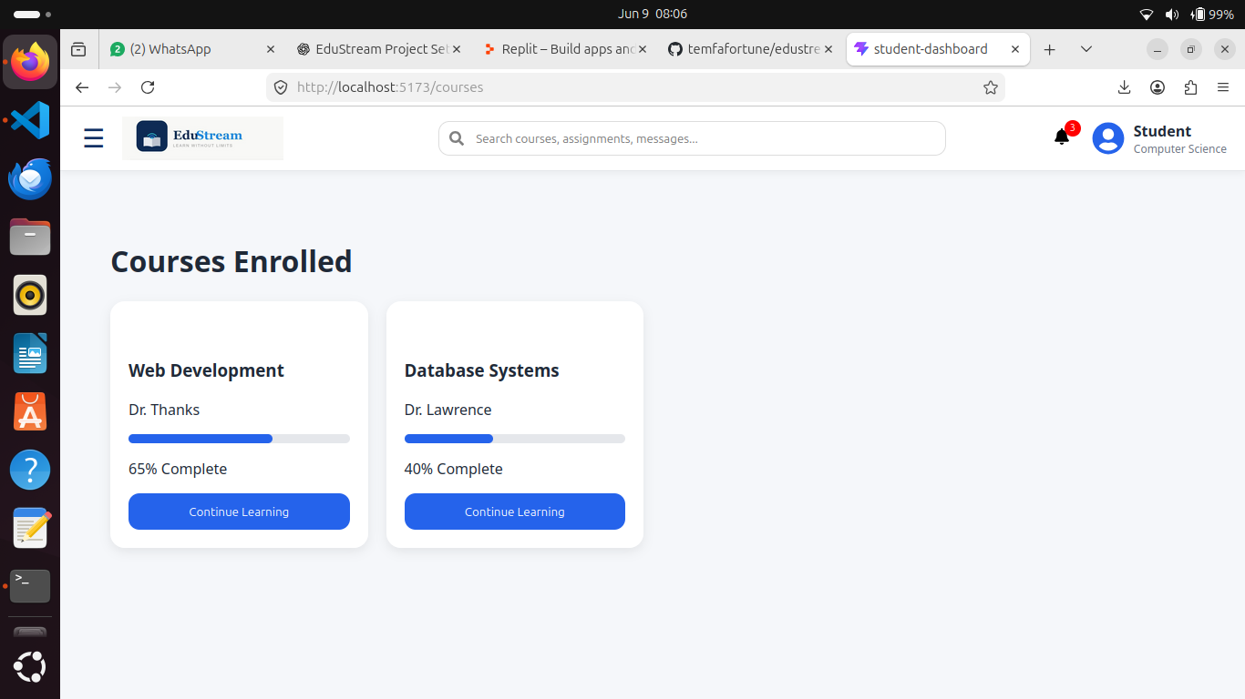
Student Panel: Interaction & Assessment

Slide 6
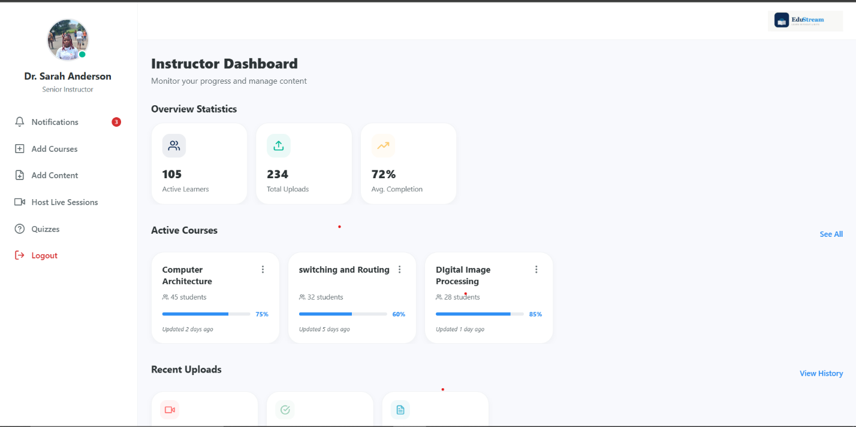
Instructor Panel: Dashboard Insights

Slide 7




Instructor Panel: Content Management
Course Management
Real-Time Activity Feed
Granular Control: Manage specific modules, reading materials, and multimedia assets within each course.
2 minutes ago
New assignment submission: "Mobile App Design" by Student #FE23A030.
Streamlined Workflow: Simplified interface for uploading new educational resources and updating existing content.
15 minutes ago
Course material "Lecture 5: Adaptive Streaming" successfully uploaded.
Interaction Monitoring: Track how students engage with specific content pieces to optimize learning paths.
1 hour ago
Student query received regarding "Quiz 2: Network Protocols".

Slide 8

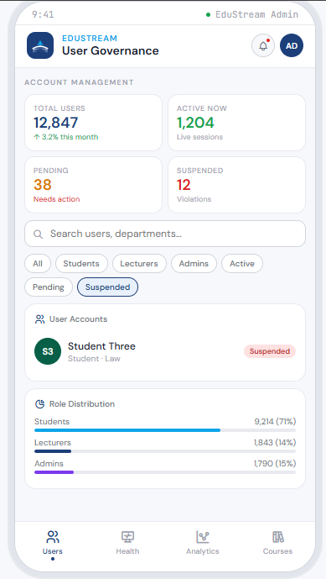
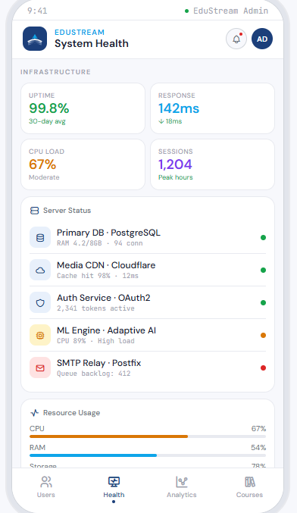
Admin Panel: Governance & Infrastructure
User Governance
Infrastructure Monitoring

Slide 9

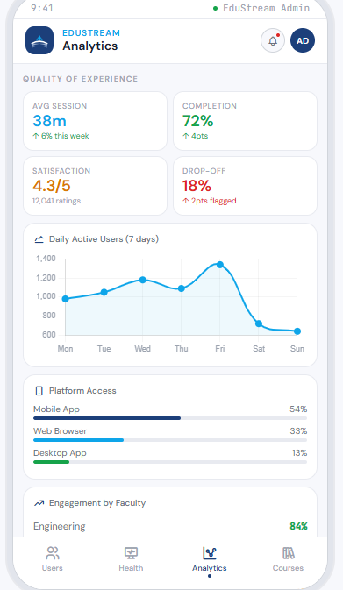
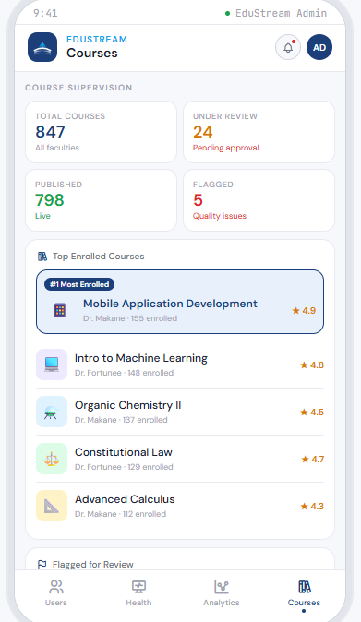
Admin Panel: Analytics & Oversight
Course & Content Supervision

Slide 10





Conclusion & Future Outlook
EduStream successfully integrates a strong brand identity with a robust, modular design to bridge the digital divide in education through adaptive streaming and mobile-first accessibility.
Key Impact
Future Vision
Removed connectivity barriers for students in low-resource settings.
Scalable architecture ready for multi-institutional deployment.
Established a professional, cohesive brand identity (EduStream).
Advanced AI-driven predictive analytics for student success.
Optimized educator workflows through streamlined content management.
Expansion of offline-first capabilities for zero-connectivity regions.
EDUSTREAM: LEARN WITHOUT LIMITS

